Slide 1
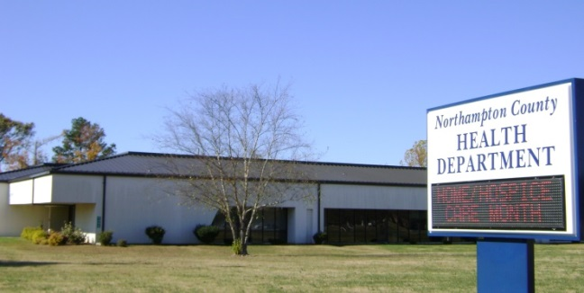
2022-2023 Statistical Report
MISSION: Promote, provide and protect the health and safety of the citizens of Northampton County.
Board of Health Handbook
Public Health Works

Slide 2
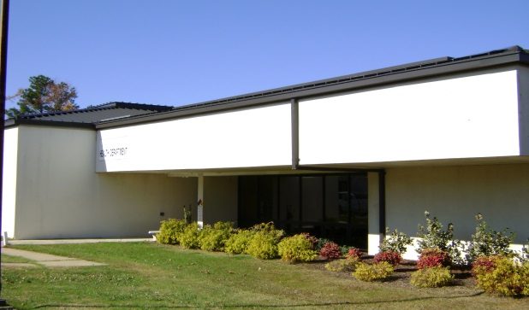
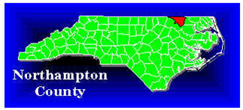
2022-2023 Statistical Report
Mission:
Promote, provide and protect the health and safety of the citizens of Northampton County.
Vision:
A culturally sensitive health organization providing quality services yielding improved health outcomes.

Slide 3
Management
2022-2023 Statistical Report
The Northampton County Board of Health and the staff of the Northampton County Health Department are pleased to present our annual statistical report for fiscal year 2022– 2023.
Megan Vick, Health Director
Management Team as of June 30, 2023
Tre Breedlove, Environmental Health Supervisor
Cheryl Warren,
Business Officer I
Sheila Person, WIC Director
Tina Edwards,
Lab Manager
Susan Finney,
Home Health Nursing Supervisor
Misty Gibbs,
Human Services Planner/Eval II
Kelly Tate, Clinical Nursing Supervisor
LEADERSHIP- megan vick, Health Director
Management Team meets on the 3rd Tuesday at 9:00 am in the Health Department Conference Room.

Slide 4
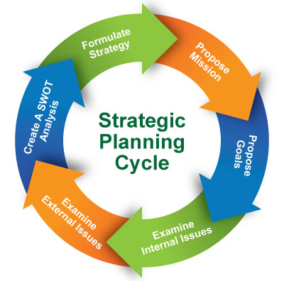
2022-2023 Statistical Report
Goals:
2022-2023 Strategic Goals
Strategic Goals
The following goals were identified in the Healthy Carolinians action plans in response to the Northampton County Health Department’s Community Health Assessment.
Goal 1 | Develop and maintain a qualified public health workforce.
Goal 2 | Continue to improve the Home Health Program.
Goal 3 | Improve and enhance the Environmental Health Program.
Goal 4 | Improve Clinical Services.
Goal 5 | Maintain the drinking water certifications.
Goal 6 | Improve the Preparedness of the Health Department and County.
Goal 7 | Improve WIC caseload through outreach.
Goal 8 | Improve and enhance Management Support Services.
Goal 9 | Address the low income/poverty issues in the county.
Goal 10 | Provide resources to the community.
Goal 11 | Educate the public on substance abuse.

Slide 5
GOVERNING BODY
Municipality Representative
Public Member representing Agriculture
The Board of Health consists of 11 members. Membership is mandated by the North Carolina General Statutes to include a registered nurse, a dentist, a veterinarian, an optometrist, a physician, a pharmacist, an engineer, a member of the County Board of Commissioners, and three members of the community at large. Each member can serve up to three consecutive three-year calendar terms.
Board of Health
Dr. Jordan White
Mr. Ben Moses Vice Chairman
Dr. Raven Deloatch
Mr. Chris Deberry
Ms. Ruth Moody
Ms. Melvetta Broadnax Taylor
Ms. Marian Mizell
Dr. Nicole Howell
Dr. William R. Futrell, Jr. Chairman
Dr. Hannah Parker
Mrs. Wanda Flythe
Pharmacist Representative
Registered Nurse Representative
Dentist Representative
Public Member representing Education
The Board of Health meets the 2nd Tuesday of every other month at 7:00 PM in the Health Department Conference Room.
Physician Representative
Positions as of June 30, 2023.
Veterinarian Representative
Professional Engineering Representative
Commissioner Representative
Public Member representing Education

Slide 6
2022-2023 Statistical Report
Calendar Year 2023 Board of Health Meeting Dates:
MONTH | DATE | YEAR
January | 10 | 2023
March | 07 | 2023
May | 09 | 2023
July | 11 | 2023
September | 12 | 2023
November | 14 | 2023
Board of Health Meetings are held in the Health Department Conference Room on the second Tuesday of every other month at 7:00 PM.

Slide 7
Board of Health Operating Procedures
Minutes.
Amendments to Operating Procedures.
These operating procedures may be amended at any regular meeting or at any properly called special meeting that includes amendment of the operating procedures as one of the stated purposes of the meeting. A quorum must be present at the meeting at which amendments are discussed and approved, and any amendments must be approved by a majority of the members present at the meeting.
Other Procedural Matters.
The Board shall refer to the current edition of Robert’s Rules of Order Newly Revised (RONR) to answer procedural questions not addressed in this document, so long as the procedures prescribed in RONR do not conflict with North Carolina law.
Compliance with North Carolina Law.
In conducting its business, the Board shall comply with all applicable North Carolina laws, including but not limited to open meetings laws, public records laws, and the laws setting forth the powers and duties of local boards of health. To assist the Board in compliance, the local health director shall maintain a current copy of relevant North Carolina General Statutes and make them available to Board members on request. Approved and adopted by the Northampton County BOH on January 11, 2007. Also included: the appeals/adjudication procedure (NC G.S. 130A-24), appointment of local health director (NC G.S. 130A-40), powers and duties of a local health director (NC G.S.130A-41), and powers and duties of a local board of health (NC G.S. 130A-39). North Carolina G.S. 130A-35 (County Board of Health appointment/terms) Board of Health training (initial and on-going). Board of Health members will receive for review a Northampton County Health Department Board of Health Handbook upon their appointment to serve on the Board of Health. The handbook includes the NC General Statutes Governing Boards of Health; Operating Procedures; Assess, Address, Assure-Manual for NC Local BOH; Association of North Carolina Boards of Health website information; Health Law (provided by the Institute of Government; The University of North Carolina at Chapel Hill ©2001); Local Government Law (provided by the Institute of Government; The University of North Carolina at Chapel Hill ©2001); Healthy People 2020; Effective Board-Health Director Relations (UNC School of Government ©2010); NCHD Orientation information (Mission Statement, BOH Members, Agency Contact Information; Organizational Chart; list of health department programs; current approved budget summary, current approved agency Strategic Plan, and Home Health information. On-going training will be provided on an annual basis during a regular designated Board of Health meeting. Topics and training materials will vary year to year.
Approved and adopted by the Northampton County Board of Health on March 16, 2023.
Name and Office.
The name of this organization is the Northampton County Board of Health (hereinafter “Board”). The principal office of the Board is located at 9495 N.C. 305 Highway, Jackson, N.C., 27845.
Officers and Committees.
Chair and Vice-Chair
The Board members shall elect a Chair and Vice-Chair by majority vote each year at the January meeting.
Secretary
The local health director shall serve as Secretary to the Board, but the director is not a member of the Board. The local health director may delegate the duties of the Secretary that are set forth in these operating procedures to an appropriate local health department employee.
Standing committees
The Board shall have the following standing committees:
Accreditation
All standing committees are subject to the North Carolina open meetings laws and shall comply with the provisions of those laws.
Meetings.
Regular Meetings.
The Board shall hold a regular meeting on the second Tuesday of every other month. The meeting shall be held in the Health Department Conference Room, J. W. Faison Administrative Building, Jackson, N.C. and shall begin at 7:00 PM.
The Secretary shall prepare minutes of each Board meeting. Copies of the minutes shall be made available to each Board member before the next regular Board meeting. At each regular meeting, the Board shall review the minutes of the previous regular meeting as well as any special or emergency meetings that have occurred since the previous regular meeting, make any necessary revisions, and approve the minutes as originally drafted or as revised. The public may obtain copies of Board meeting minutes at the Northampton County Health Department.

Slide 8
Board of Health Operating Procedures
2022-2023 Statistical Report
Attendance. *
Any board member who is absent from three consecutive regular board meetings shall be dismissed from the board unless the board specifically excuses such absences.
An absence will be excused when notice is provided in advance of the meeting or the absence is deemed by the Board of Health as an emergency. *
Approved and adopted by the Northampton County Board of Health on July 12, 2007.
An absence will be excused when notice is provided at least two days in advance of the meeting or the absence is deemed by the Board of Health as an emergency.
* Amended by the Northampton County Board of Health on February 09, 2012.
Designation of Chair
The chair of the Board shall preside at board meetings if he or she is present. The chair shall have the right to vote in all cases. If the chair is absent, the vice-chair shall preside. If both the chair and vice-chair are absent, another member designated by vote of the board shall preside.
Quorum
A majority (6) of the actual membership of the board (11) shall constitute a quorum. The chair shall be considered a member of the board in determining the number on which a majority is based and in counting the number of members actually present. A member who has withdrawn from a meeting without being excused by majority vote of the remaining members present shall be counted as present for purposes of determining whether or not a quorum is present.
Approved and adopted by the Northampton County Board of Health on June 11, 2009.
Agenda.
The Secretary to the Board shall prepare an agenda for each meeting. Any board member who wishes to place an item of business on the agenda shall submit a request to the Secretary at least three working days before the meeting. For regular meetings, the Board may add items to the agenda or subtract items from the agenda by a majority vote. The agenda for a special or emergency meeting may be altered only if permitted by and in accordance with the North Carolina open meetings laws.
Any person may request that an item be placed on the Board’s agenda by submitting a written request to the Secretary at least fourteen working days before the meeting unless considered an emergency by the Health Director.
Presiding Officer.
The Chair of the Board shall preside at Board meetings if he or she is present. If the Chair is absent, another member designated by a majority vote of members present at the meeting shall preside. If the Chair is absent, the Vice-Chair shall preside. If the Chair and Vice-Chair are both absent, another member designated by a majority vote of members present at the meeting shall preside.
Voting.
Each Board member shall be permitted to abstain from voting, by so indicating when the vote is taken. A member must abstain from voting in cases involving conflicts of interest as defined by North Carolina law. If a member has withdrawn from a meeting without being excused by a majority vote of the remaining members, the member’s vote shall be recorded as an abstention.
Approved and adopted by the Northampton County Board of Health on March 16, 2023.

Slide 9
Agency Staff/Discipline:
as of June 30, 2023
2022 - 2023 Statistical Report
Name Discipline
Name Discipline
ALLEN, SHERRY ARD, LINDA | Office Assistant IV PHN II – Home Health
BREEDLOVE, TRE BROWN, KAREN | Environmental Health Supervisor Social Worker II - CMHRP
BRYANT, TESSA BYNUM, ULANDIS | Processing Assistant IV – Home Health Breastfeeding Peer Counselor
COCKE, CATHY DAYE, CHRISTINA | Accounting Technician II – Home Health Processing Assistant IV
DICKENS, KIERRA DUKE, AMY | Social Worker II – CMARC PHN II – Jail Health
DUKE, BERNADETTE DUNLOW, MANDY | PHN II – General Clinic Administrative Assistant II
EDWARDS, TINA EVERETTE, CYNTHIA | Medical Lab Technologist I PHN II – Communicable Disease
FAISON, CATHERINE FINER, WENDY | Processing Assistant IV – WIC PHN II – Child Health
FINNEY, SUSAN FLYTHE, LANA | PHN Supervisor II – Home Health Accounting Clerk IV
FLYTHE, TINA GARY, KYSHA | Processing Assistant IV – MH/FP Appts Health Educator I
GIBBS, MISTY GLOVER, ELLEN | Human Services Planner, Evaluator II PHN II – Contract
GRIFFIES, ROBIN HORSLEY, EDWIN | PHN II – Home Health Processing Assistant IV – Child Hlth Appts
HOWARD, KATIE JOHNSON, JULIA | Environ. Health Specialist-Onsite PHN II – MH/FP
JONES, KRISTY LEARY, LATONIA | Animal Shelter Attendant Patient Relations Rep. V – Billing Spvr.
LEGGETT, BRETT MATTHEWS, CINDY | PHN II – Home Health LPN II Home Health
PEARSON, ANGELO PERSON, SHEILA | Animal Welfare Services Spvr. Nutritionist II – WIC Director
PILAND, JAMIE SIMMONS, MARY BETH | FNP Patient Relations Rep. IV - Billing
STEPHENS, BRITTANI | Environmental Health Specialist-Food & Lodging
TATE, KELLY VICK, MEGAN | PHN Supervisor II – Clinic Health Director
WARREN, CHERYL | Business Officer I

Slide 10
Financial Information
2022 - 2023 Statistical Report
.
2022-2023 REVENUE COLLECTED:
$2,600,313.14
NORTHAMPTON COUNTY HEALTH DEPARTMENT
YEAR TO DATE FINANCIAL STATEMENT
June 30, 2023
 |  | BUDGETED: |  | YTD COLLECTED |  | % COLLECTED
FEES |  | 34,600.00 |  | 61,805.95 |  | 178.6%
HOME HEALTH |  | 821,500.00 |  | 871,006.08 |  | 106.0%
STATE/FEDERAL |  | 1,229,324.00 |  | 1,187,297.90 |  | 96.6%
MEDICAID |  | 149,312.00 |  | 426,783.65 |  | 285.8%
GRANTS |  | 83,483.00 |  | 53,419.56 |  | 64.0%
TOTALS |  | 2,318,219.00 |  | 2,600,313.14 |  | 112.2%

Slide 11
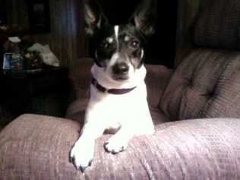
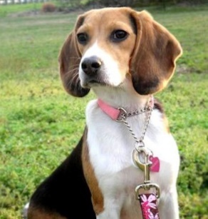
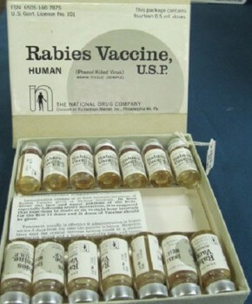
Animal Control
2022-2023 Statistical Report
2022-2023 Numbers:
Dogs Impounded 265
Cats Impounded 174
Dogs euthanized by Shelter 53
Cats euthanized by Shelter 67
Dogs adopted (Rescue included) 150
Cats adopted (Rescue included) 83
Vaccination Clinics Held 3
Vaccines given to dogs 587
Vaccines given to cats 70
Total Vaccines given during Clinics 657
Dogs Reclaimed 59
Cats Reclaimed 1
Spay/Neuter Vouchers issued 43
Pet Adoption Program

Slide 12
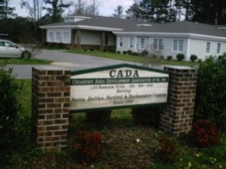
EAT SMART COOK
Child Health
2022-2023 Statistical Report
 | CHILD HEALTH
 | 2022-2023
191 | Total Patients
 | Plan Category
40 | Uninsured/Patient Pay
146 | Medicaid
3 | Blue Cross Blue Shield
2 | Commercial Insurance
Head start
The Health Department served 430 Head Start children and
108 Early Head Start children FY 2022 – 2023.
Performed hearing and vision screenings for all children enrolled once yearly. Performed monthly review of children’s health record to assess physicals, immunizations & health care plans. Tracked Well Child checks and immunizations and notified parents when due.
We also served 11 pregnant woman in this program.
-Provided 1st Trimester education, 3rd Trimester education and postpartum education in the home setting.
Served on HeadStart/Early HeadStart Advisory Committee: 2 meetings per year.
Child Health Program
English Speaking 174
Spanish Speaking 17

Slide 13
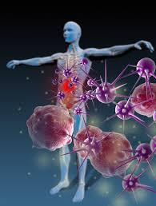
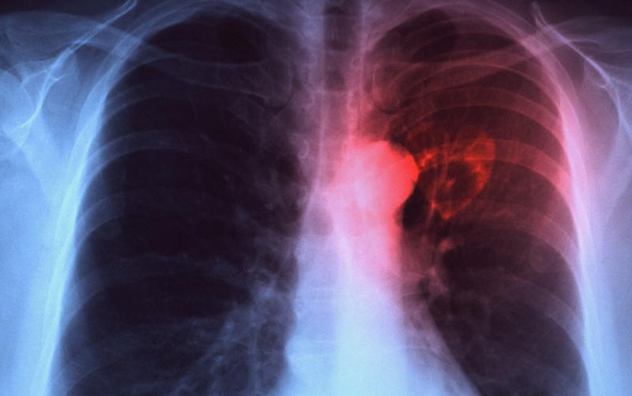
2022-2023 Statistical Report
Communicable Disease
HIV/AIDS
Counseling & Testing 0
Tuberculosis
TB cases on drugs 0
Contacts on drugs 0
Reactors on drugs 0
Patients with TB & HIV 0
Sputum tests for TB 3
Positive TB skin tests 0
New reported TB case 0 Suspected case of 0
Office visits (Directly Observed Therapy) 0
Communicable Disease Reports
Chlamydia 176 Hepatitis B Carrier 2
Gonorrhea 78 Lyme’s Disease Suspect 2
Salmonella 1 Rocky Mountain Spotted Fever 2

Slide 14
WATER & SEWAGE
S-1 Site Visits | 337
S-1E Sites Evaluated | 177
S-4 IP Issued New/Revision w/Site | 58
S-7 Improvement Permits Denied | 15
S-8 Construction Auth. New/R/R | 59
S-10 Construction Auth. Repair | 26
S-11 Construction Auth. Denied | 3
S-13 Auth. Existing System Reuse | 16
S-15 NOV Issued | 12
S-16 Legal Remedies Issued | 2
S-17 Permits Revoked Notice | 10
S-19 OP Issued NEW | 35
S-19 OP Issued EXPANSION | 2
S-19 OP Issued REPAIR | 22
S-25 Sewage Complaints Invest. | 6
S-27 On-Site Consultative Contact | 692
S-40 Improvement Permit Issued | 4
S-41 Construction Auth. Issued | 3
W-1 Well Sites Evaluated | 11
W-2 Well Grout Inspections | 3
W-3 Well Site Consultative Visit | 23
W-4 Well Head Inspection | 2
W-6 Well Const. Permit Issued | 12
W-8 Well Abandonment Permit | 5
W-10 Well Cert. of Comp. Issued | 1
W-13 New Well Kit | 5
W-14 Other Samples Collected | 26
W-16 Well Consultative Contacts | 76
W-22 Variance Requests | 1
W-23 Health Risk Evaluation | 20
FOOD AND LODGING
FH-1 Inspections
FH-1 FOOD STAND | 9
FH-1 MEAT MARKET | 12
FH-1 MOBILE FOOD UNIT | 13
FH-1 PUSHCART | 62
FH-1 RESTAURANT | 2
FH-1 SCHOOL/FACILITY | 28
FH-1 SCHOOL LUNCHROOM | 12
FH-1 DAYCARE | 1
FH-1 LOCAL CONFINEMENT | 1
FH-1 LODGING | 8
FH-1 NURSING HOME | 7
FH-1 NURSING HOME/DIETARY | 5
FH-1 RESIDENTIAL CARE | 5
FH-1 SWIMMING POOL | 5
FH-1 TATTOO ESTABLISHMENT | 1
FH-2 Non-Permtted Operation Closed
FH-2 DAYCARE | 3
FH-3 Visits
FH-3 FOOD STAND | 4
FH-3 MOBILE FOOD UNIT | 3
FH-3 RESTAURANT | 12
FH-3 SCHOOL/LUNCHROOM | 3
FH-3 DAYCARE | 1
FH-3 LODGING | 1
FH-3 PUSHCART | 2
FH-3 NURSING HOME/DIETARY | 1
FH-3 RESIDENTIAL CARE | 2
FH-3 TATTOO ESTABLISHMENT | 1
FH-12 Consultative Contacts
FH-12 FOOD STAND | 5
FH-12 MEAT MARKET | 5
FH-12 MOBILE FOOD UNIT | 8
FH-12 PUSHCART | 2
FH-12 RESTAURANT | 11
FH-12 RESIDENTIAL CARE | 2
FH-12 DAYCARE | 3
FH-12 LOCAL CONFINEMENT | 0
FH-12 TATOO ESTABLISHMENT | 2
FH-12 NURSING HOME | 1
FH-12 OTHER INSTITUTION | 2
FH-12 SWIMMING POOL | 5
FH-4 Pre-opening/Const.
FH-4 Pre-opening visits | 2
FH-5 Permits Issued
FH-5 MOBILE FOOD UNIT | 2
FH-5 SWIMMING POOL | 4
FH-5 RESTAURANT | 5
FH-5 MEAT MARKET | 1
FH-5 TATTOO ESTABLISHMENT | 1
FH-9 Plans Reviewed
FH-9 RESTAURANT | 4
FH-9 MOBILE FOOD UNIT | 1
FH-9 MEAT MARKET | 2
FH-13 Transitional Permits Issued
FH-13 RESTAURANT | 2
HE-1 | 13
HE-3 | 1
HE-6 | 3

Slide 15
Family planning
2022-2023 Statistical Report
 | FAMILY PLANNING
 | 2022-2023
152 | Unduplicated Patients
20 | Teens (19 and under)
120 | Insured
32 | Uninsured
6% | Non-English speaking patients
Payer Sources
108 | Medicaid
2 | Medicare
30 | Self Pay
5 | Private Ins.
7 | Commerical

Slide 16
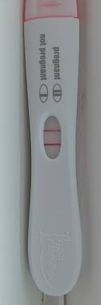
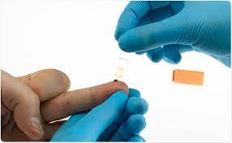
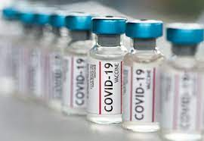
GENERAL CLINIC SERVICES
2022-2023 Statistical Report
TB Skin Tests Given | 101
TB Skin Tests Read | 79
TB Screening forms | 19
Blood Pressure | 5
Blood Sugar | 45
Hemoglobin Checks | 61
Hepatitis B Vaccines | 16
HIV Results | 474
HIV Testing | 474
Tests Results | 474
Adult Immunizations | 161
Children Immunizations | 449
Pregnancy Tests | 68
STD Male | 86
STD Female | 87
Nurse Practitioner Adult Visits | 147
Nurse Practitioner Children Visits | 68
Urine Checks | 166
Condoms | 150
STD Treatment Only | 55
Flu Shots | 92
COVID Vaccines | 507
COVID tests | 264

Slide 17
2022-2023 Statistical Report
Home health
Northampton County Home Health Agency has provided home care services to patients in Northampton County since 1976.
The Agency is owned and operated by Northampton County Local Government and housed in the Northampton County Health Department.
Home Health services through Northampton County Home Health Agency are available to those who:
Live in Northampton County or the surrounding area
Are in need of home health services
Are under the care of a doctor
Home Health Care is provided by a highly trained staff working directly under the written orders of a physician. Services are provided in the comfort of the patient’s home. Services may include: skilled care, skilled nursing, physical therapy, speech therapy and CAP/DA.
2022-2023 Numbers
Skilled Nursing Visits 2,165
Physical Therapy Visits 2,449
Speech Therapy Visits 109
CAP/DA Patients Seen 38
Northampton County Health Department d/b/a Northampton County Home Health Agency 9495 NC 305 Highway Jackson, NC 27845 Accreditation Details Dates: 1/1/2023 through 1/1/2026
Program: Home Health (Deemed)
Services: Physical Therapy Services, Skilled Nursing Services, Speech Therapy Services, CAP/DA

Slide 18
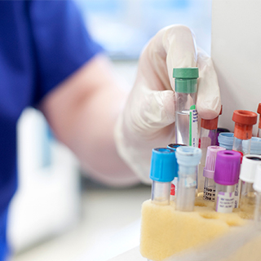
2022-2023 Statistical Report
Laboratory
Tests performed in-house-- 1,200
Water samples – total-- 260
4-year average of clients tested— 5,600
4-year average of in-house QC, PT and Water tests completed— 4,800
4-year average of sent out for testing—1,200
The Northampton County Health Department and Home Health Agency is certified by CLIA (Clinical Laboratory Improvement Amendments). This certificate allows us to perform moderately complex laboratory testing.
The Northampton County Health Department Laboratory is also certified by the North Carolina Department of Health and Human Services, State Laboratory of Public Health to perform Total Coliform and E. Coli Analyses on North Carolina water supplies.

Slide 19
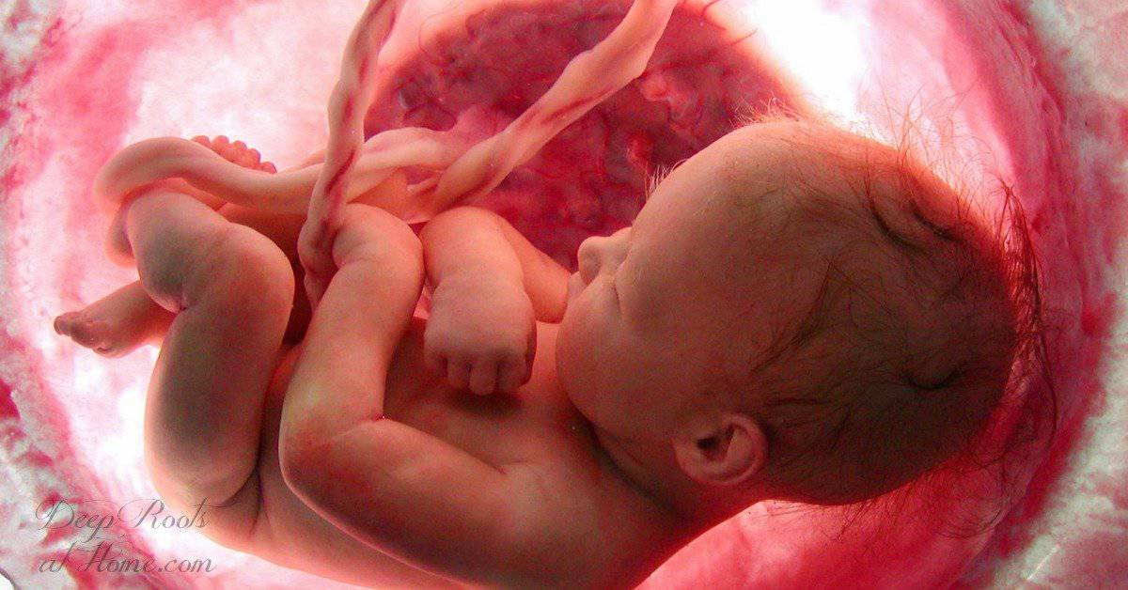
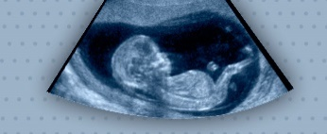
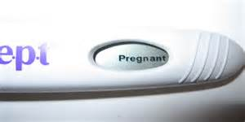
Services Provided: Prenatal care including guidance and health education for labor and deliver, child care, safety, and family planning. Physicals, in-house lab testing, and services for teens and adults. We have a Nutritionist on staff that is available for weight and diabetic prenatal needs. Home visits for clients with high risk pregnancy issues are available as well as assistance with transportation needs for those who qualify.
Maternal Health
2022-2023 Statistical Report
In order to give your baby a healthy start in life, it is vital to begin your prenatal care early in your pregnancy and continue this care throughout your entire pregnancy. Your baby's health is closely tied to yours. If you are pregnant, or considering getting pregnant, our maternity health services offers comprehensive prenatal care including services after you deliver.
Who is eligible?
Females of any age with a positive pregnancy test.
Numbers:
Receiving Clinic Services 22 (21 Medicaid and 1 Non-Medicaid Patient)
Teen Patients—2 Age 35+ years---8
Clients Served by County
of Residence:
Northampton County 22
 | Payor Source
1 | Commercial
21 | Medicaid
Postpartum Assessments --
There was one Non-English speaking maternal patient.

Slide 20
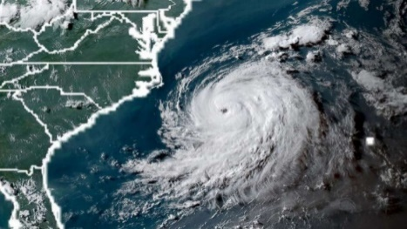
Preparedness & response
2022-2023 Statistical Report
2022-2023 COVID-19 Response NC stopped posting COVID data in May 2023. There were 5971 total cases of COVID recorded in Northampton County for all time and 100 deaths for all time. (Archive) COVID-19 Cases and Deaths Dashboard | NC COVID-19 (ncdhhs.gov) COVID vaccination data stopped being recorded in April 2023. 44% of residents in Northampton completed the 1st series of shots. 54% of those people got at least 1 booster. 22% received the latest booster. (Archive) COVID-19 Vaccinations Dashboard | NC COVID-19 (ncdhhs.gov)
Through our Public Health Preparedness & Response (PHP&R) program, the Northampton County Health Department's Preparedness Coordinator, along with local emergency management and first responders, aim to work with the community to keep Northampton County citizens prepared and safe during any disaster.

Slide 21
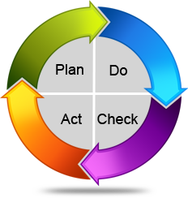
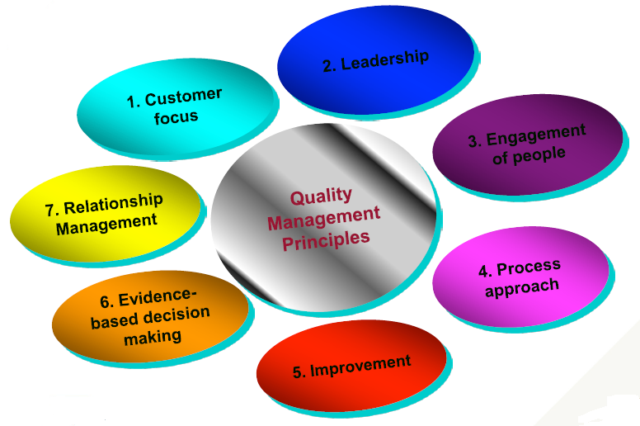
Quality Improvement
2022-2023 Statistical Report
QUALITY IMPROVEMENT
2022-2023
- Cultural Diversity training for all employees was in April 2023 - Safety Training was completed by all employees in August 2022 - Fit Testing was completed by all employees in August 2022 - Client Satisfaction Surveys results were given to the BOH May 2023

Slide 22
Numbers
WIC
2022 - 2023 Statistical Report
WIC is a Special Supplemental Nutrition Program funded by the United States Department of Agriculture. This program provides nutritional education to women (pregnant, postpartum and breastfeeding), infants and children to age 5. Participants receive an EWIC card, with which their food benefits may be purchased at authorized WIC Vendors.. For more information contact the Northampton County Health Department at 252-534-5841.
Who is eligible?
Pregnant, postpartum and breastfeeding women who meet the required criteria
Infants and children to age 5.
NOTE: Eligibility is determined based on income, medical nutrition risk and residence
Number of Clients served—6,238
An average of participants were served per month.--519

Slide 23
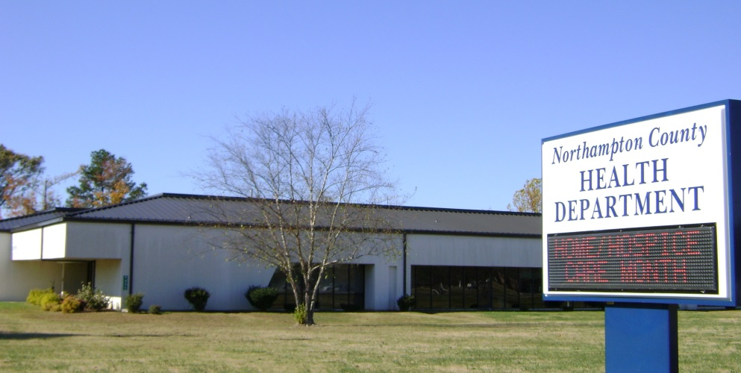
Contact Information
2022 - 2023 Statistical Report
Phone:
252-534-5841
(Health Department)
252-534-1291 (Home Health)
FAX:
252-534-1045
252-534-1207 (Administration)
252-534-1064 (Home Health)
Northampton County Health Department
9495 NC Hwy. 305
Post Office Box 635
Jackson, NC 27845
Visit our website for more information:
We are on Facebook!
www.northamptonhd.com

